Slide 1





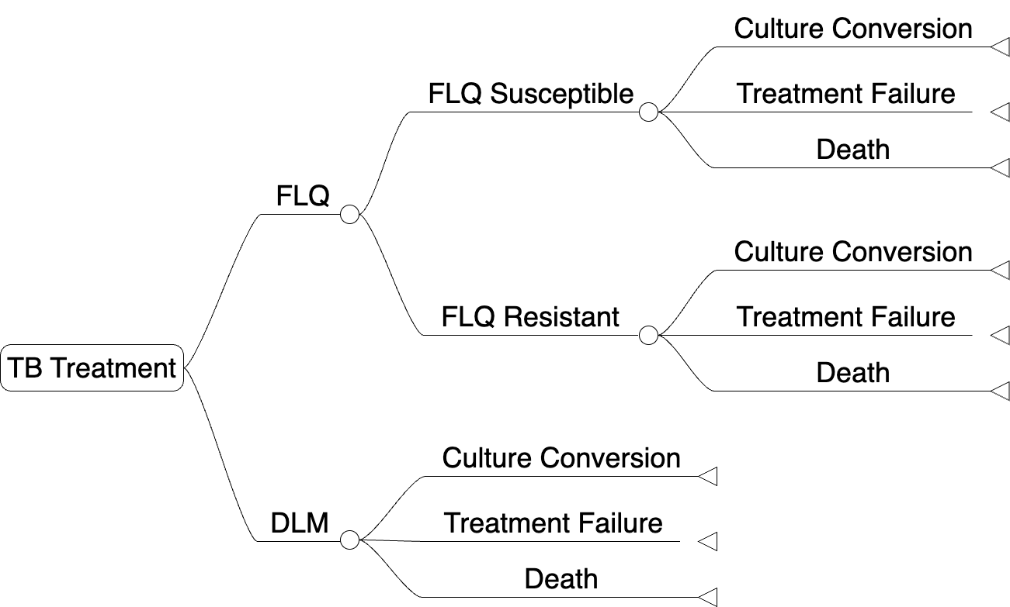
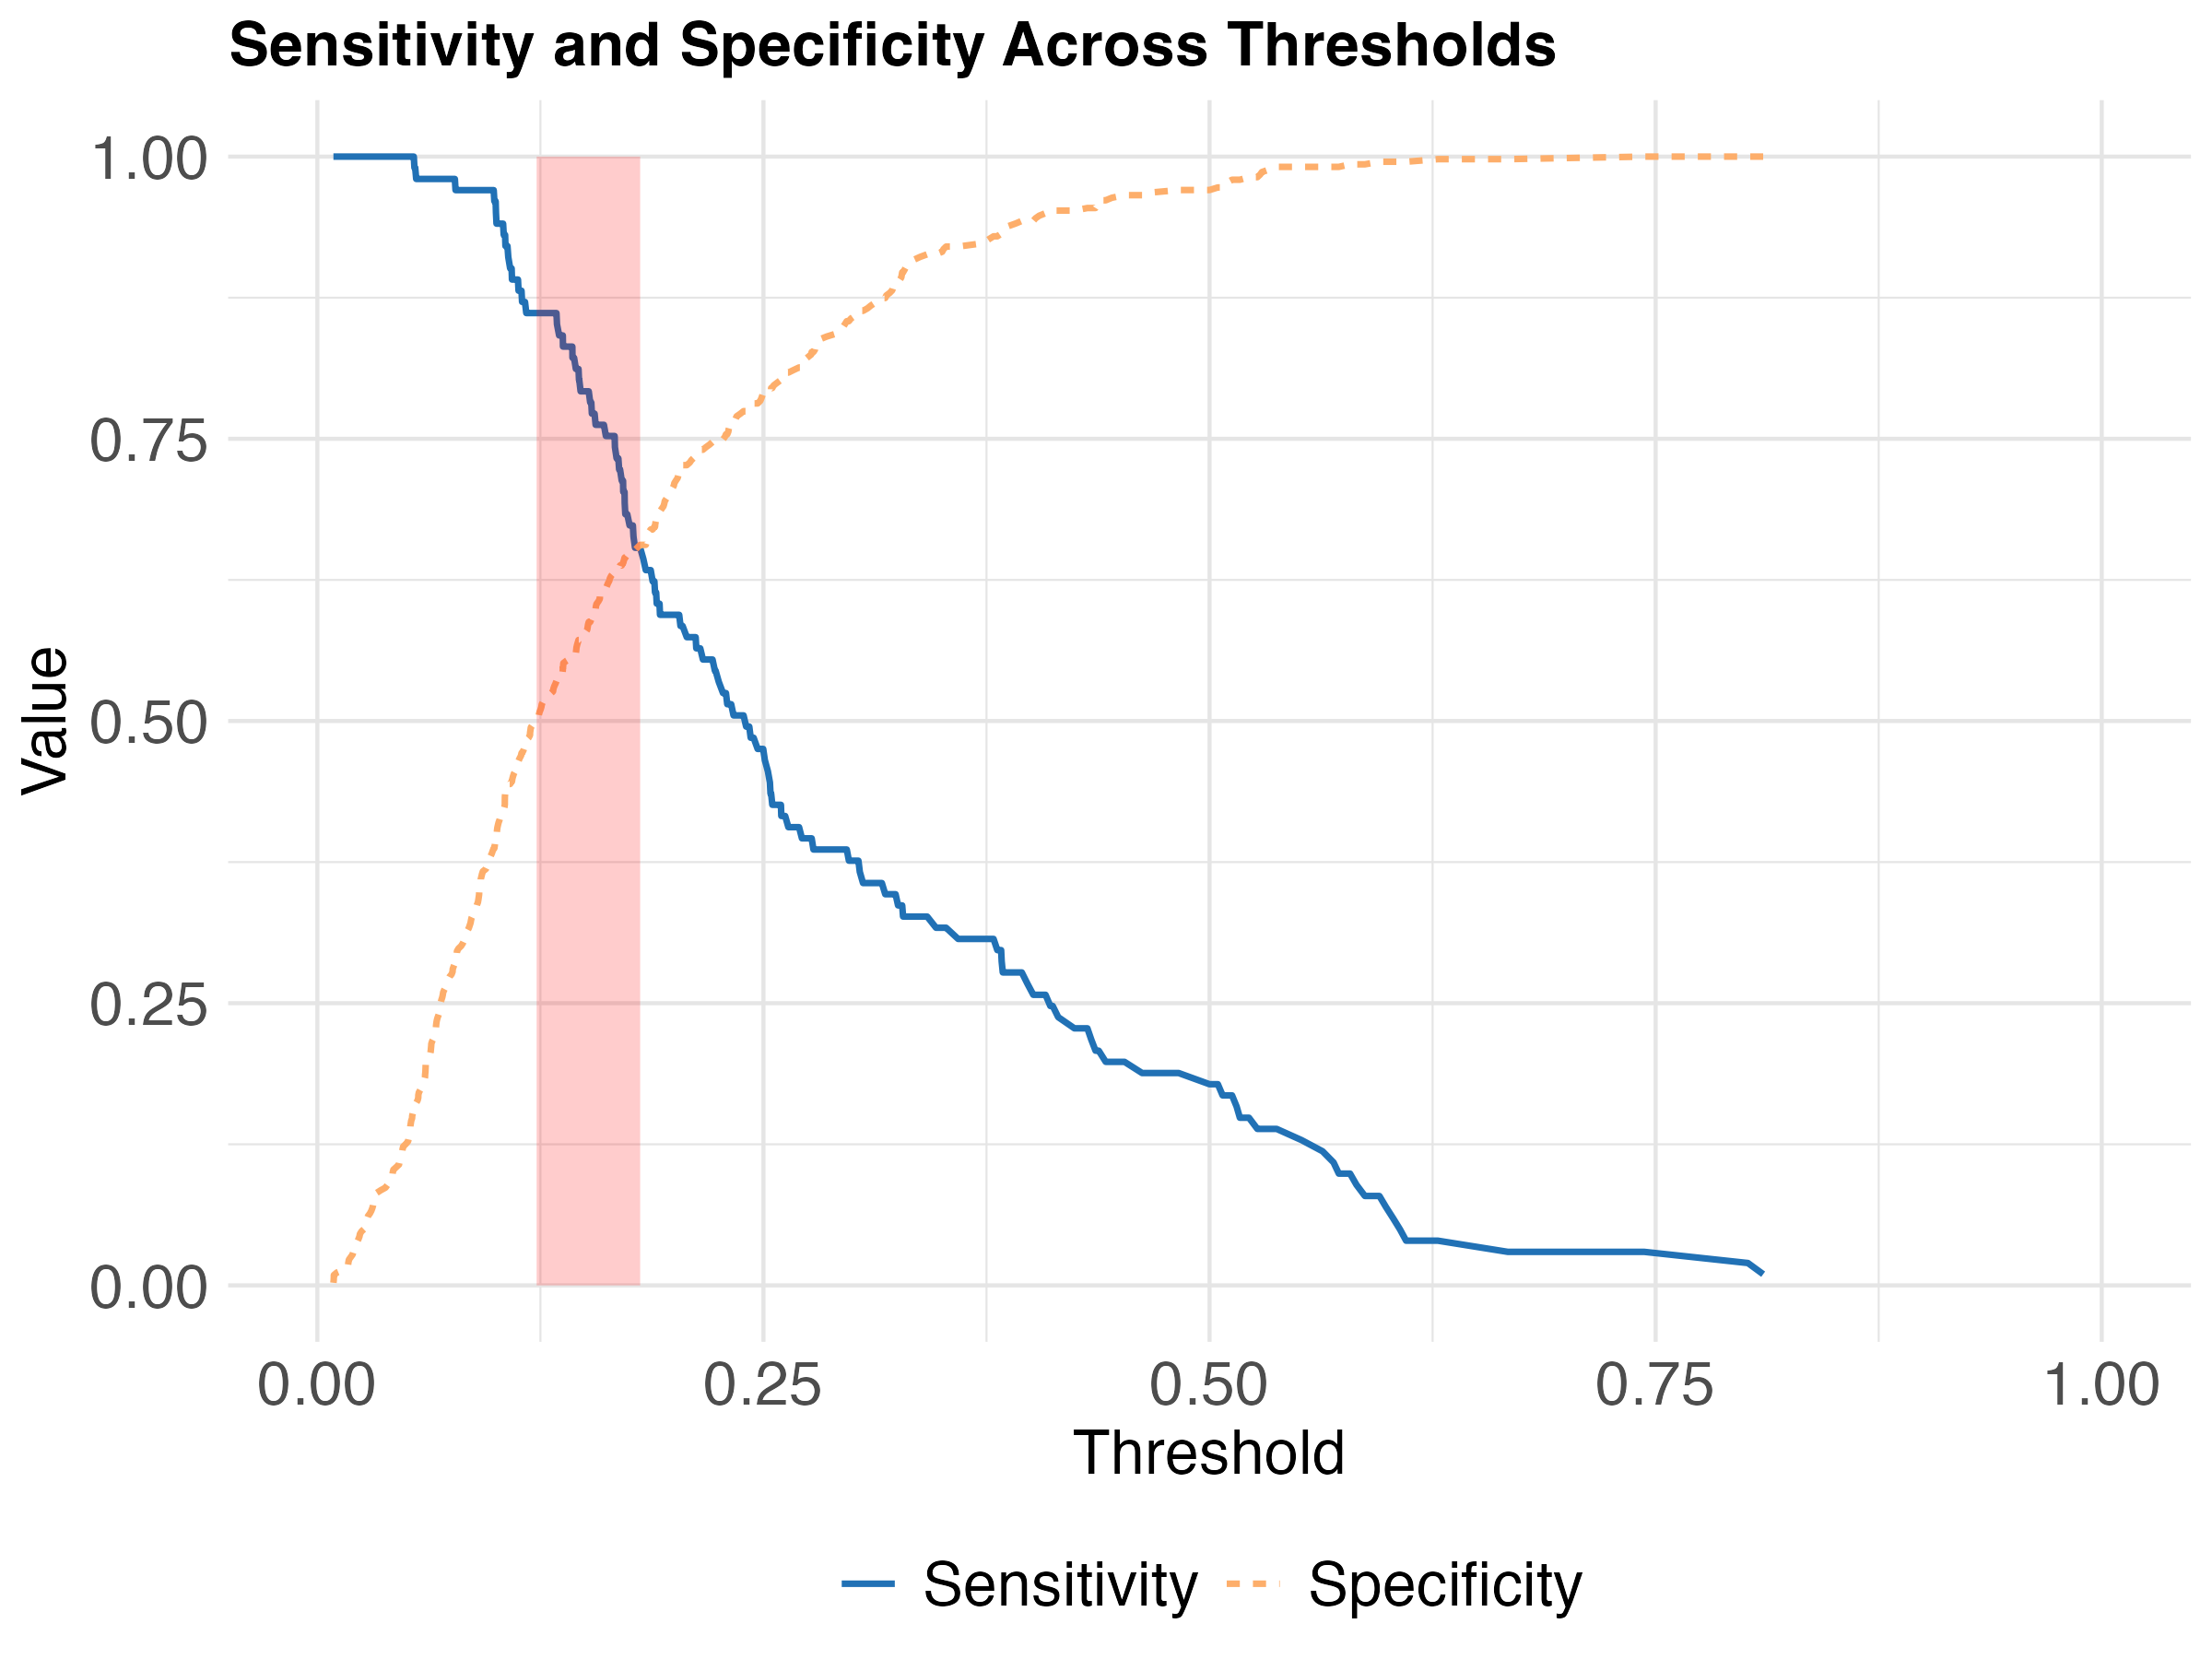
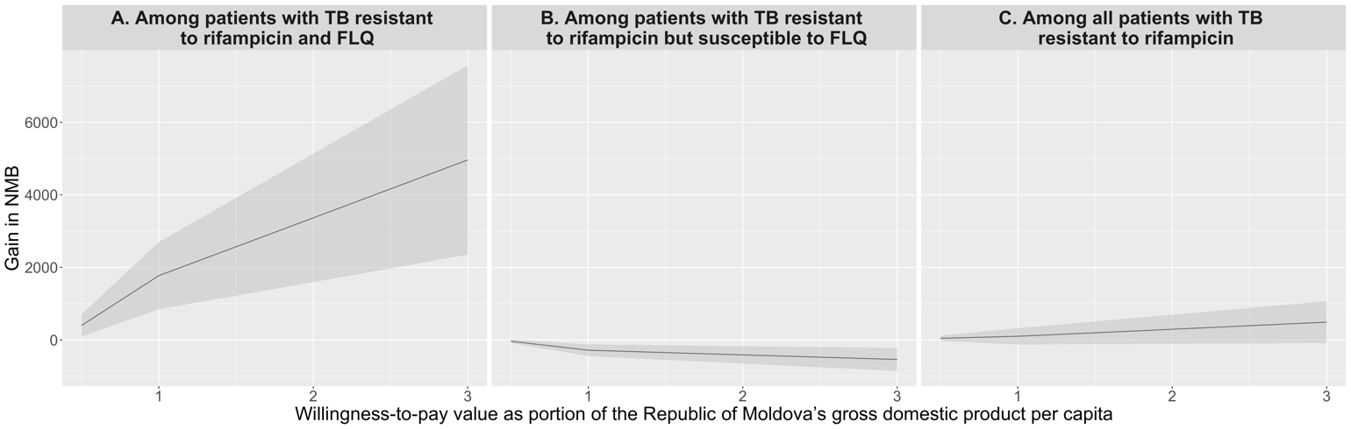
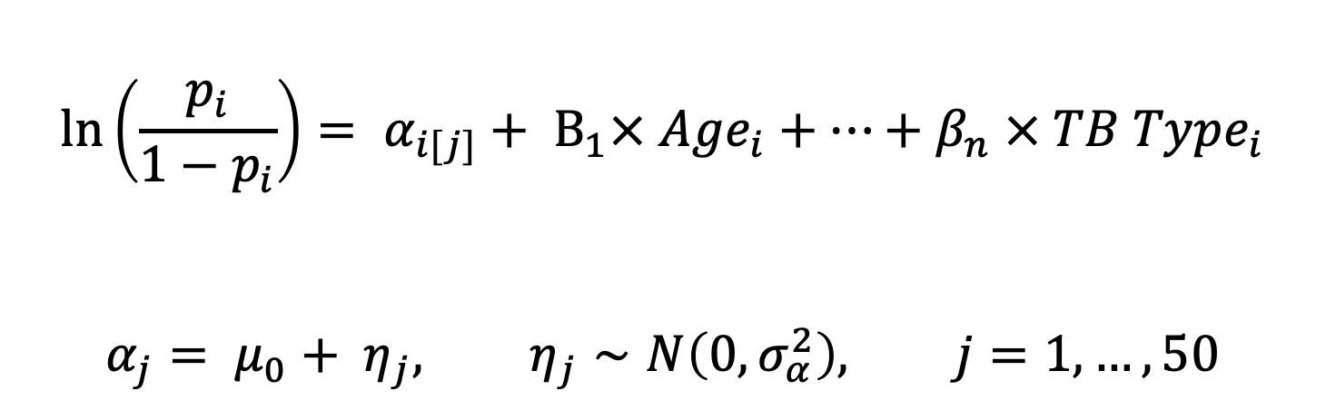
Using prediction models to inform cost-effective treatment recommendations at the point of care
Mariana Neves, PhD^{1,2}, Reza Yaesoubi, PhD^{1,2}
¹ Department of Health Policy and Management, Yale School of Public Health, New Haven, CT, USA
² Public Health Modeling Unit, Yale School of Public Health, New Haven, CT, USA
Summary
Due to limited access to drug susceptibility tests, the treatment of patients with rifampicin-resistant tuberculosis (RR-TB) is often empiric and based on standardized guidelines. In 2020, the World Health Organization (WHO) endorsed a novel treatment regimen for RR-TB, known as BPaLM. However, recent rises in the prevalence of resistance to fluoroquinolones (FLQ), an important antibiotic class present in the BPaLM regimen, have challenged the effectiveness of this regimen. In this context, a key question is whether certain patients with RR-TB should be treated with a modified version of the BPaLM regimen in which FLQ is replaced with delamanid, another important second-line antibiotic but with lower resistance prevalence.
Methods
We developed a decision tool by combining a predictive model and a decision tree. The predictive model is a hierarchical logistic regression trained and validated with the records of 540 patients with RR-TB, reported in the Republic of Moldova between January 2018 and December 2019. We used this model to estimate the probability that a RR-TB infection is also resistant to FLQ based on patient’s demographic and clinical information (e.g., age and tuberculosis history). The resistance probabilities predicted by the model are fed into a decision tree to project the cost and disability-adjusted life-years (DALYs), while accounting for toxicity and efficacy associated with each regimen. Given a willingness-to-pay (WTP) threshold, the decision tool selects the regimen with the lowest expected loss in net monetary benefit (NMB) as the optimal treatment.
Results
The gain in NMB from using our decision tool to inform treatment regimen varied between patients depending on FLQ resistance status (Panels A and B). A statistically significant gain in NMB was observed among patients with TB resistant to rifampicin and FLQ (Panel A). However, this gain was accompanied by a comparatively small loss in NMB among patients with TB resistant to rifampicin but susceptible to FLQ (Panel B). Among all patients with RR-TB, the average gain in NMB was positive across different WTP thresholds (Panel C).
Conclusions
The personalized treatment regimens recommended by the developed decision tool are expected to increase the NMB among patients with RR-TB compared to using the standardized regimens for all patients. However, the overall gain in NMB may be accompanied by a loss among patients with FLQ-susceptible TB.
Figure 1. Gain in net monetary benefit (NMB) from using the develop decision tool to inform treatment regimens compared to using the standardized regimen for all patients with RR-TB. The shaded regions show the 95% confidence intervals.
Rifampicin-resistant tuberculosis
Predicting rifampicin-resistant tuberculosis
Case Study: Optimizing Rifampicin-Resistant Tuberculosis Treatment
Rifampicin-resistant tuberculosis
Predicting Rifampicin-resistant tuberculosis
0.5 million People annually, fall ill with multidrug-resistant and rifampicin-resistant TB
Rifampicin is the most powerful first-line anti-TB drug.
Fluoroquinolones are a class a class of second-line anti-TB drug
If resistance to Fluoroquinolones is suspected, Delamanid (DLM) can be prescribed.
$$\ln\left(\frac{p_{i}}{1−p_{i}}\right)= α_{i[j]}+ Β_{1}× Age_{i}+…+β_{n} × TB Type_{i}$$
$$α_{j}= μ_{0}+ η_{j}, η_{j}∼N\left(0, σ_{α}^{2}\right), j=1, …, 50$$
Individual level
District level
Disclosures:
Authors have no conflict of interest to disclose.

